Slide 1

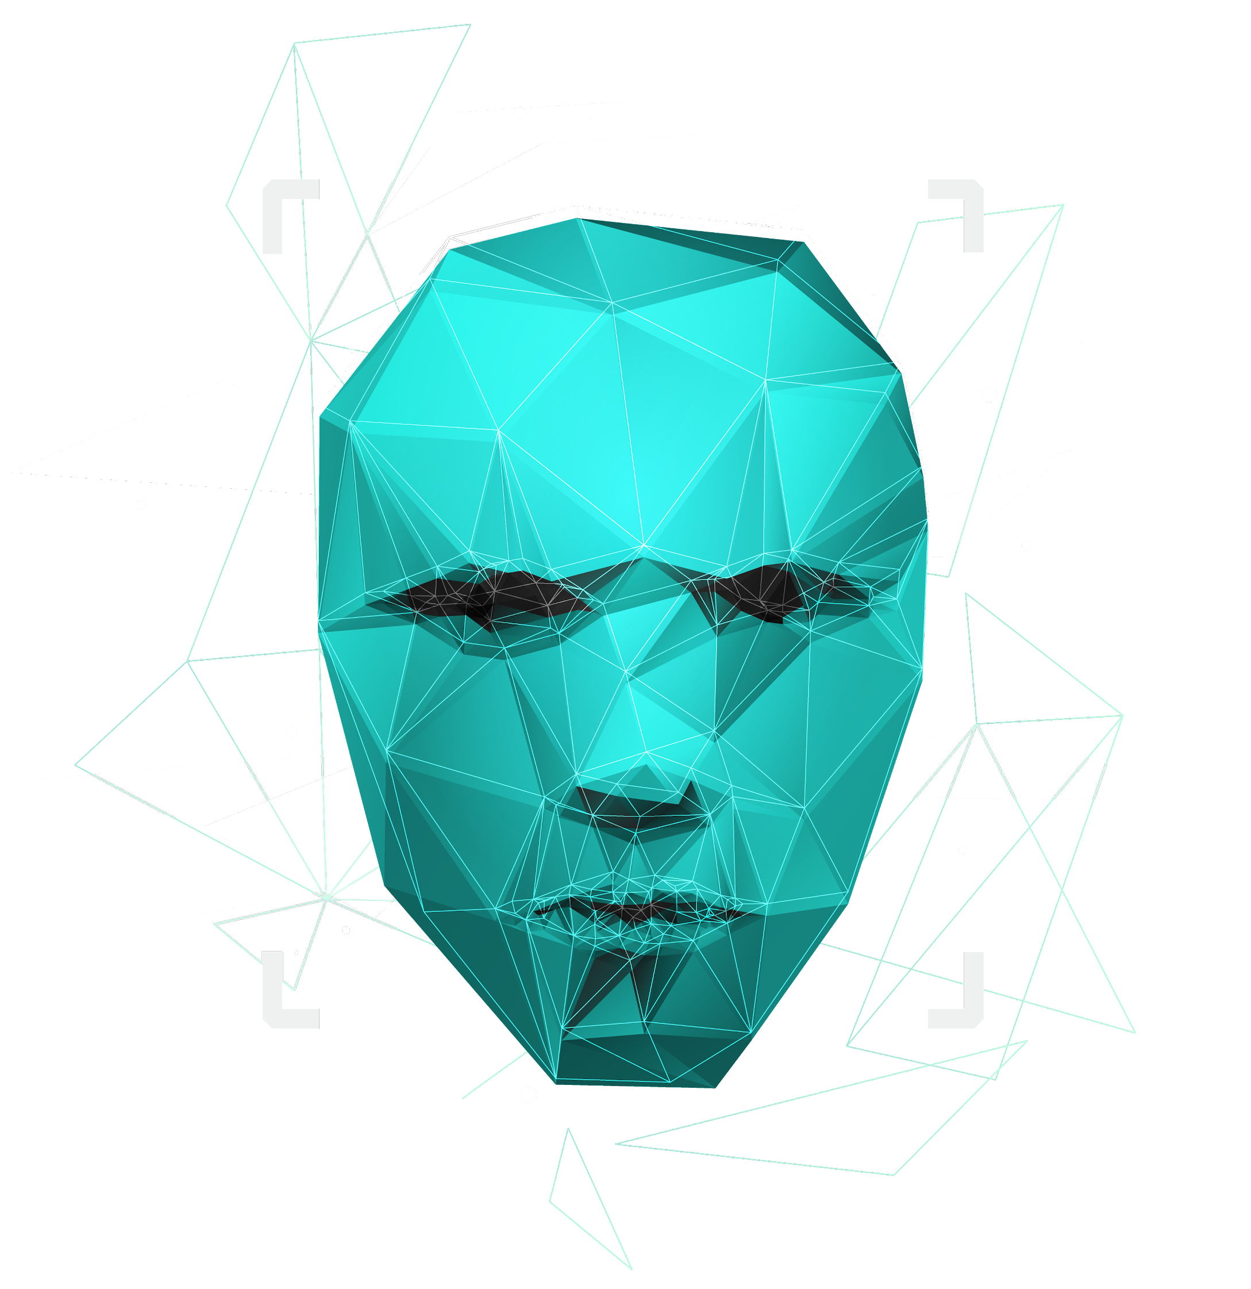
“Where’s Waldo”
By Dellius Alexander & Austin Daigle

Slide 2
Project Objective:
This project aims to implement TensorFlow with voxel51 and Acandond3 to create a machine learning model to identify human faces from an image.

Slide 3

Mechine Learning Organization:
Docker Container
A container-based development platform that houses the model and building environment.
TensorFlow
TensorFlow is the end-to-end open-source machine learning platform that constructs the primary model used in this project
51 Containers
The class container system used with coordination with TensorFlow (it even has it built-in) to create identification classes for the machine learning environment.

Slide 4

How it’s works:
TensorFlow uses the 51’s datasets and model defintions to create a general-purpose image recognition model that can identify human, animals, and items.
Docker contains all of the major environments, dependancies, and models rendered.
51’s datasets and definition in combination with TensorFlow further identifies faces from the image inputs and outputs that into the model results
Upon the conclusion, we have implemented 51’s built-in UI and interface to show the model results and provide an interactive analysis platform.

Slide 5
The End…

